Slide 1
Rendering Techniques in Gears of War 2
Niklas Smedberg
Senior Engine Programmer
Epic Games, Inc.
Daniel Wright
Engine Programmer
Epic Games, Inc.

Slide 2
About Epic Games
19th year of business
110 employees in NC and still hiring
Creators of Unreal Engine 3
Shipped Gears of War 2
Shipped Unreal Tournament 3
Xbox 360, PC and PS3
External studios in Poland, Shanghai, and Utah

Slide 3
About Gears of War 2
93% Metacritic rating
Over 4 million copies sold
117 award wins and nominations
Shipped in two years by Gears 1 team

Slide 4
About Niklas Smedberg
A.k.a. “Smedis”
C64 Swedish demo scene
Went pro 1997
Moved to the US in 2001
Shipped titles for PS1, PC, Xbox, Xbox 360, PS3
Joined Epic Games 2005

Slide 5
Topics Niklas Smedberg
Gore techniques
Blood techniques
Character lighting
Screen Space Ambient Occlusion optimizations
Notes:
Combine many different types of effects to achieve the final look.

Slide 6
THE FOLLOWING PRESENTATION HAS NOT BEEN RATED FOR
ALL AUDIENCES
VIEWER DISCRETION IS ADVISED
Notes:
Gears of War is Mature-rated for a reason.
Not a GWAR show, but still…

Slide 8
Gore Goals
Goals:
No seams between breakable pieces (Gears of War 1 used rigid 1-bone skinning)
Dismember skinned meshes (e.g. ragdolls)
Hand-modeled internals
Minimal impact on undamaged meshes
Notes:
Gears 1 only supported 1-bone skinning for breakable meshes.
In Gears 2 we wanted to dismember characters properly with soft 4-bone skinning.
Show ripped internals of a character in it’s full glory.
Hand-modeled and hand-textured geometry for everything – cuts, internals, damaged surfaces. No procedural geometry or texturing.
While adding all this detail, we didn’t want this to affect the performance of undamaged meshes. They should still run at optimal speed with no overhead.

Slide 9
Gore Mesh
Artists make two versions of the skinned mesh
Undamaged mesh with no overhead
Gore mesh with additional information:
Completely independent of the undamaged mesh
Full freedom to hand-model cuts and guts
Can use different/additional textures and shaders
Pre-cut with all gore pieces separated

Slide 10
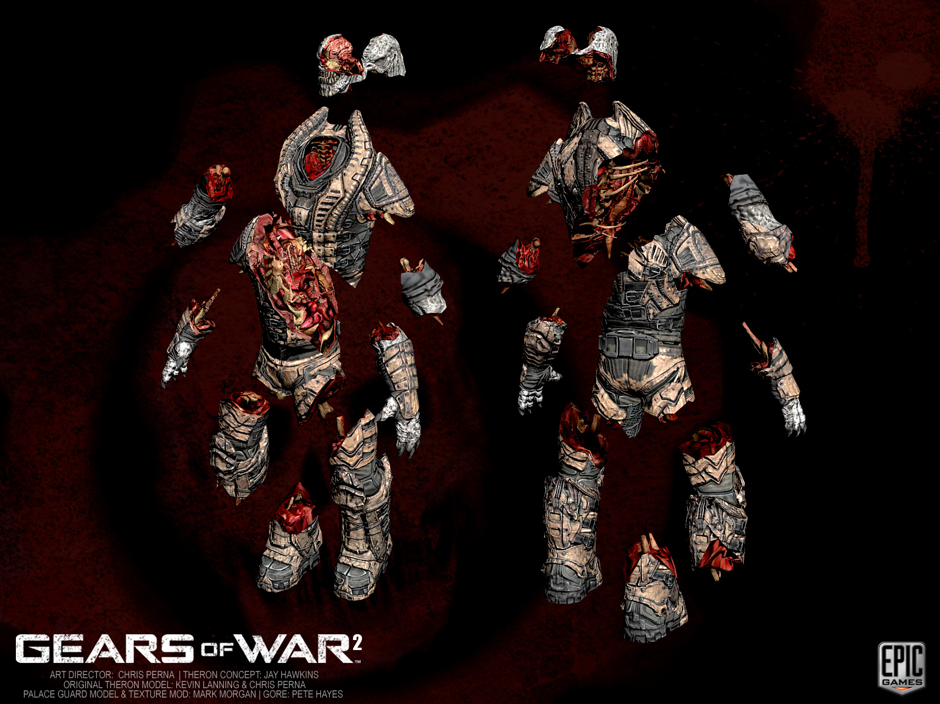
Locust gore mesh
Picture: Locust gore mesh
Notes:
Here you can clearly see where the chainsaw is going to cut through the mesh. You can see the internal geometry. Everything is hand-made.

Slide 11
Gore Mesh
Skeleton with breakable joint constraints
Broken by script code - not using physics engine (as in Gears 1)
More control of when/how to break the constraints
Info per gore piece:
Hit points
Type of special effect
Dependency of other gore pieces
Etc
An extra set of bone weights for all vertices:
Hand-made 4-bone weights
Weighted to properly separate all gore pieces along the cuts
Notes:
“Emergent behavior” doesn’t always generate what you want… ;)

Slide 12
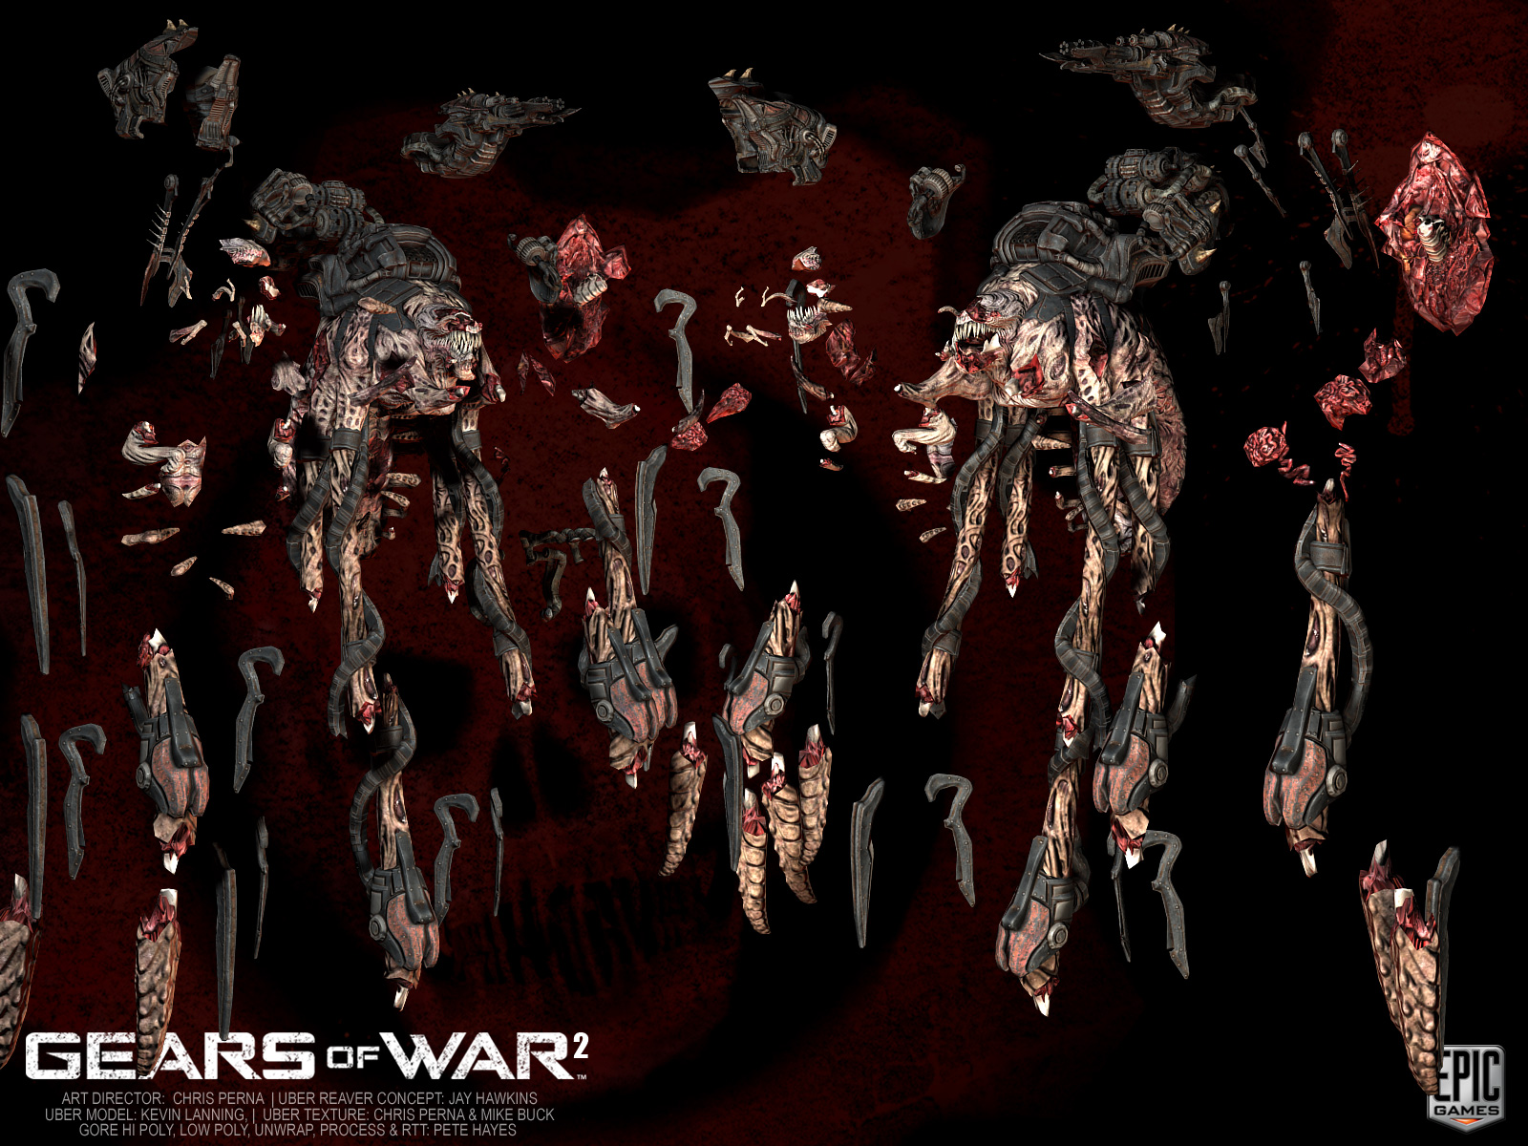
Elaborate gore mesh
Picture: Uber reaver gore mesh
Notes:
Some gore meshes can be pretty elaborate.

Slide 13
Tearing off a limb
Switch to the gore mesh
Determine which constraint to break
Get the pair of broken bones
Create a separate vertexbuffer for vertex weights
Unique per gore mesh instance
Replaces all weights in the original vertexbuffer
Used as a separate vertex stream
For each vertex:
If influenced by a broken bone, copy 2nd set of weights
Otherwise, copy 1st set of weights
Add physics impulse to the torn-off limb
Let physics move the limb away
Notes:
Data-driven: Impact distance, hit points, dependency links, leaf first.
Gameplay desicisions: Headshot always chooses the head.
The vertex buffer is only created upon first use.
Handles all broken constraints in one go.
Can also play a user-specified special effect.

Slide 14
Data-driven Gore
Set up in the Unreal Editor
Only used for really big enemies (e.g. Brumak)
Used as visual “damage states”
Not necessarily to break off whole limbs
Gore pieces stacked on top of each other
Break “armor pieces”, damage flesh, etc.
Hit-points, impact radius, dependency links (leaf first), etc

Slide 15
Data-driven Gore, 1 of 3
Notes:
Undamaged Brumak

Slide 16
Data-driven Gore, 2 of 3

Slide 17
Data-driven Gore, 3 of 3

Slide 18
Scripted Gore
Set up in gameplay code (Unreal Script)
Only dismember dead people
No animation/gameplay consequences
Different damage types break constraints differently
Complete obliteration (e.g. grenade-tag)
Partial obliteration (e.g. shotguns)
Headshots spawn additional effects (gibs)
Hand-made gib meshes can be specified per Pawn
Chainsaw breaks specific constraints
Ragdolls break constraints based on hit location

Slide 19
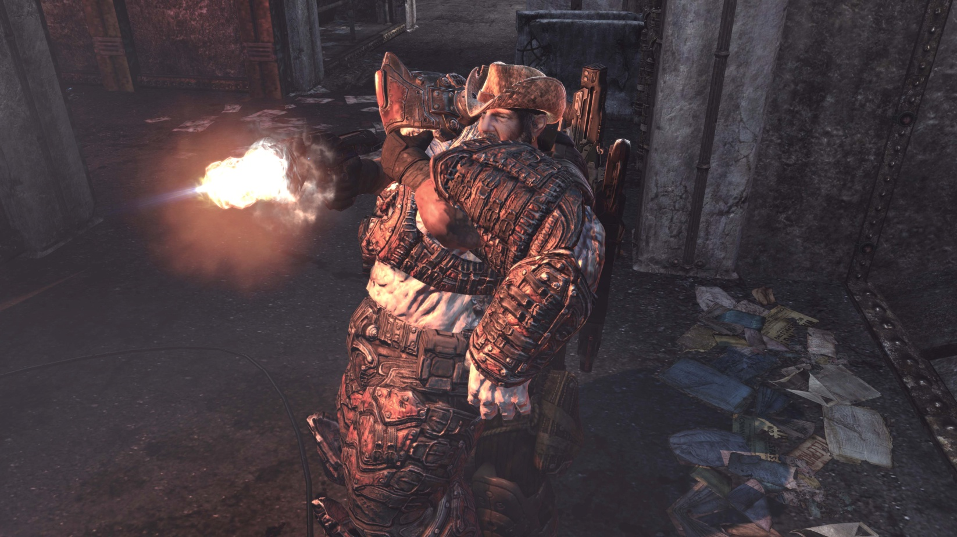
Next Example: Meatshield
Meatshields break constraints in a pre-determined sequence
Based on overall “health” for the entire meatshield
Used as gory visual indicator instead of a boring “health bar”
Notes:
Special case: you can still do a headshot on a meatshield and “insta-kill” it.

Slide 20
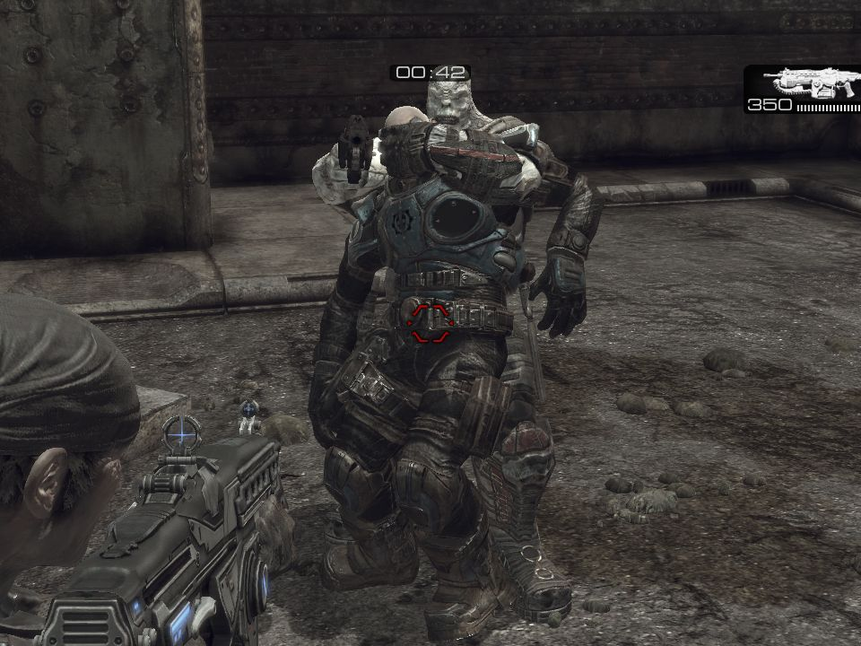
Data-driven gore #1
Screenshot: Meatshield 1
Notes:
Screenshot: Meatshield 1
Example of a sequence of gore pieces broken off.
Using original un-damaged mesh here!

Slide 21
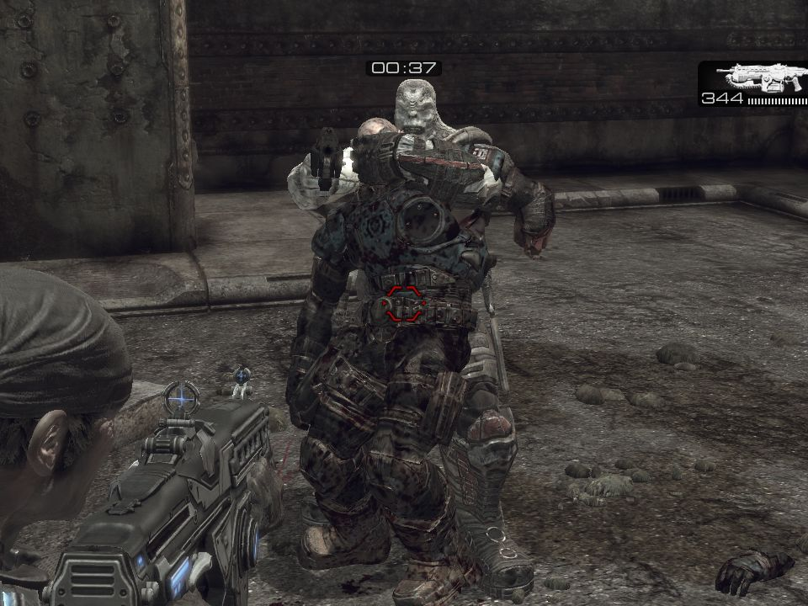
Data-driven gore #2
Screenshot: Meatshield 2
Notes:
Screenshot: Meatshield 2
Notice that we switched to the gore mesh!
It’s textured a bit differently to begin with, then we break off the left hand.

Slide 22
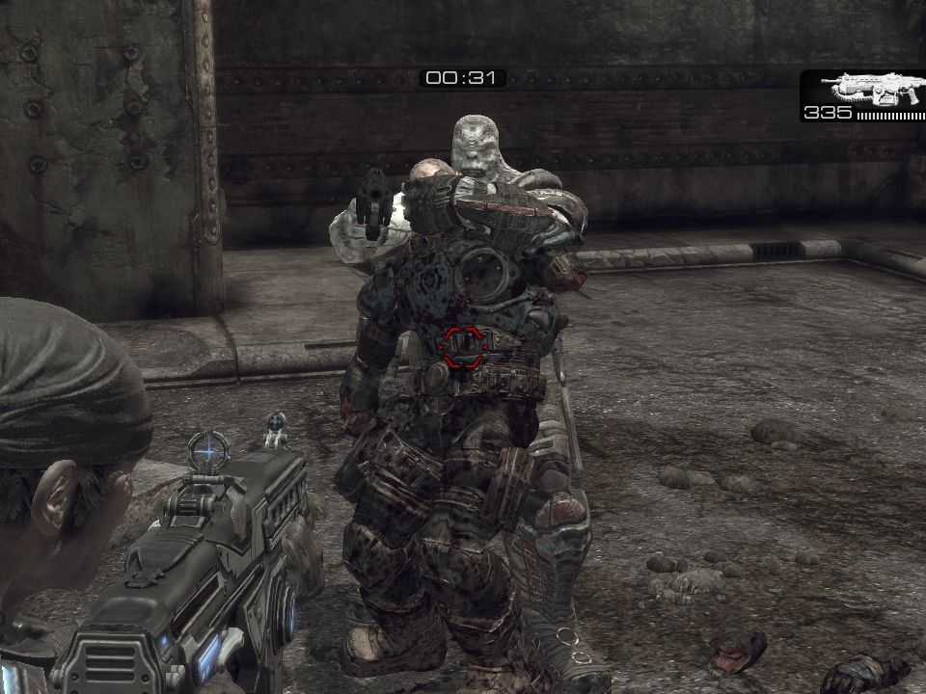
Data-driven gore #3
Screenshot: Meatshield 3
Notes:
Screenshot: Meatshield 3

Slide 23
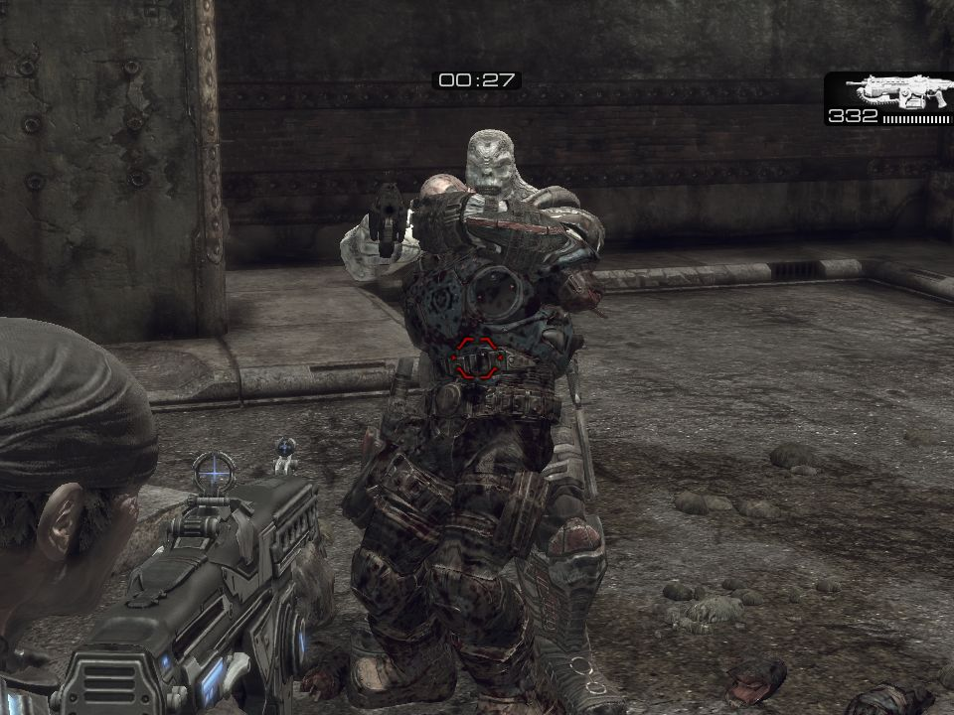
Data-driven gore #4
Screenshot: Meatshield 4
Notes:
Screenshot: Meatshield 4

Slide 24
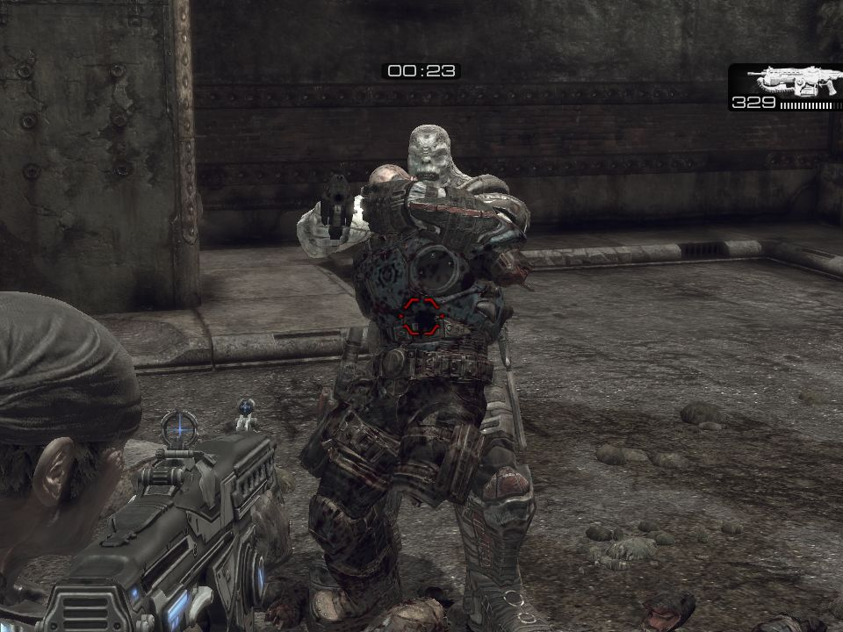
Data-driven gore #5
Screenshot: Meatshield 5
Notes:
Screenshot: Meatshield 5

Slide 25
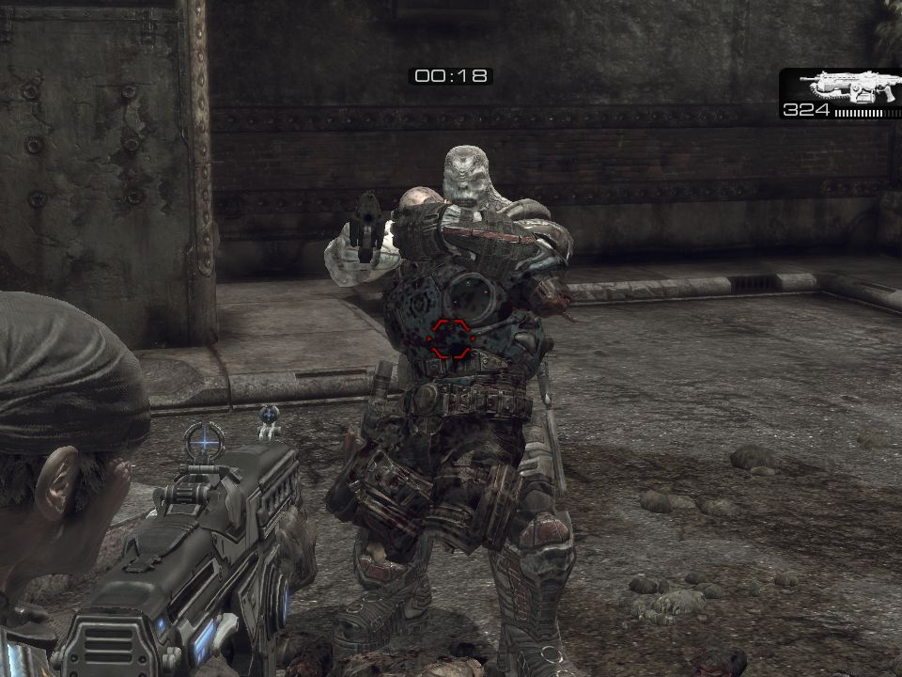
Data-driven gore #6
Screenshot: Meatshield 6
Notes:
Screenshot: Meatshield 6

Slide 26
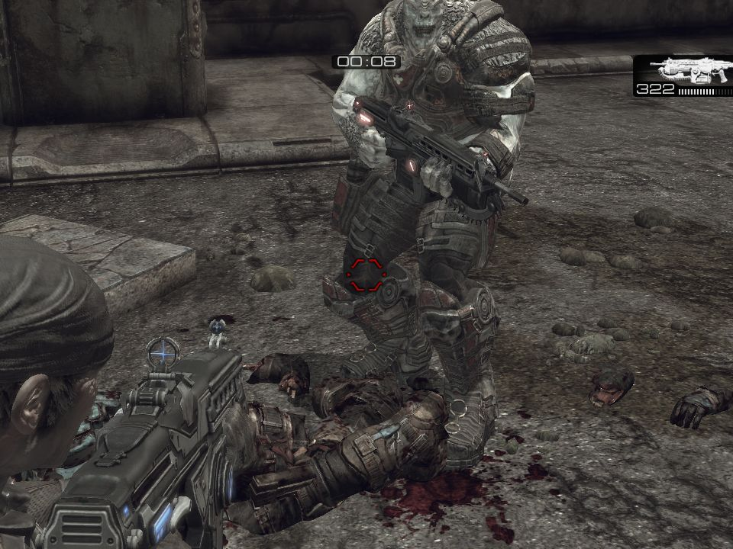
Data-driven gore #7
Screenshot: Meatshield 7
Notes:
Screenshot: Meatshield 7
Mission accomplished.

Slide 27
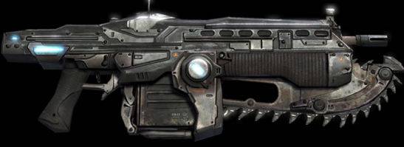
Next Example: Chainsaw
Chainsaw kill:
Gameplay code choosing a specific constraint to break

Slide 28
Scripted gore
Movie: Chainsaw
Notes:
Movie: Chainsaw kill.
Example of gameplay code deciding a specific constraint to break.

Slide 29
Topics Niklas Smedberg
Gore techniques
Blood techniques
Character lighting
Screen Space Ambient Occlusion optimizations

Slide 30
Blood Techniques
Many different techniques used in combination:
Projected blood decals
Screen-space blood splatter
World-space particle effects
Surface-space shader effects
Fluid simulations
Morphing geometry
Notes:
The final effect is more than just the sum of its parts. Combining effects is key.

Slide 31
Blood Techniques
Movie: Riftworm heart chamber, chainsawing through arteries
Notes:
Movie: Riftworm heart chamber, chainsawing through arteries.
Show-casing many different techniques: Gore, world-space particles, blood fluid simulation, surface-space blood shader, screen-space blood, etc.

Slide 32
Decal Features
Decal system much improved over Gears 1
Much easier to spawn decals on anything
Supports any artist-created material (shader), lighting, blend mode, normal maps, animated, render-to-texture, etc
Three decal pools:
Blood decals, explosion decals, bullet decals
Blood splatter unaffected by the number of bullet hit-marks
Heuristic to replace oldest decal (when necessary):
Oldest not visible decal (LastRenderTime)
Oldest visible decal (Lifetime)
Proximity check to avoid multiple decals on top of each other

Slide 33
Decal Optimizations
AABB tree to find triangles within the decal frustum
These triangles are not clipped
Decals have their own index buffers
Re-use whole triangles from the base mesh vertexbuffers
Frustum-clipping handled by GPU:
clip(), early-out branch, scissor test
Decal visibility tests:
Re-use base mesh visibility test
Decal-specific frustum and distance check
Decals on fractured meshes:
Re-use the fragment-visibility check
Upon fracture, re-calculate affected decals only

Slide 34
Decal Optimizations
One drawcall per decal, but:
This allows for scissoring
Each decal is fully featured
Statically lit decals re-use lightmaps from underlying surface
Dynamically lit decals use additive multi-pass lighting
Decals on dynamic objects:
Projections are in local space
Re-use matrix to follow the mesh
Decals on static objects:
Placed in the various static drawlists (“fire and forget”)
Static decals (manually placed in editor):
Pre-clipped geometry (no clipping on GPU)

Slide 35
Example: Blood Smears
Project decals on ground and on cover walls when you’re hurt
Project a new decal every 0.5s while moving
Using fading “paintbrush” effect along movement direction
Overall fade + “paintbrush” fade
Shader parameter curves exposed to artists
Mix with standard blood decals to break up pattern

Slide 36
Blood Smears, 1 of 4

Slide 37
Blood Smears, 2 of 4

Slide 38
Blood Smears, 3 of 4

Slide 39
Blood Smears, 4 of 4

Slide 40
Screen-space Blood Effects
Screen-space blood splatter:
Spawned by level design (Kismet), animation (AnimNotify nodes) or script code
3D particle effects that use camera-facing particles
Game code re-positions these camera-effects each frame
Allows for more dynamic “screen-space” effects
Full-featured 3D particle effects
Artist-made materials (shaders)
Like any material, can take shader parameters from gameplay script code
Meshes, sprites, movie textures, normal-mapping, etc
Notes:
90 units in front of the camera
The particle effect adjust itself to make sure it’s always larger than the largest viewport (aspect ratio/resolutions/etc)

Slide 41
World-space Blood Effects
World-space 3D particle effects
Use world-space coordinates for fake lighting on sprites and gibs
Can make up-facing pixels brighter, etc
Normal-mapped sprites helps
4x6 “movie frames” in a sub-UV texture to get realistic motion
2048x1024 color map + 1024x512 normal map
Re-used for most liquid-type effects
Mix meshes and sprites to achieve a better 3-D feeling
Mix additive and translucent blending to work well in both dark and bright areas

Slide 42
Surface-space Blood Effects

Slide 43
Example: Surface-space
Inside the Riftworm, characters use a blood shader
One scalar shader parameter (0-1) to indicate amount of blood
Texture masks for bloody regions and pattern
Scroll textures downwards in texture-space
Gradient pattern & normalmap
(Roughly correlates to down in world-space)
Masks and shader parameter multiply
Used as lerp factor between a constant blood color and un-bloodied color
Blood color have negative Blue and Green components
Produces slight discoloration in the transition areas
ALL_SoldierShaders.SinglePlayer.Bloody.SoldierShader_Bloody
Notes:
Kismet works in conjunction with a cinematic to also control other things (e.g. height of the pool of blood).
Triggered by gameplay events.

Slide 44
Fluid Simulation
Using our Unreal Engine 3 fluid simulation feature
Allows the player to wade through large pools of blood
Ability to raise / lower the entire fluid
Controlled by a triggered cinematic
Simulated on separate thread
Height-field tessellated on GPU
No vertex buffer to update, all vertices are created on-the-fly on GPU
The height-field is used as a dynamic vertex texture
(Not all platforms)

Slide 45
Example: Riftworm Heart Chamber
Many different techniques in combination:
Gore mesh
Screen-space blood splatter
World-space blood particle effects
Surface-space shader effect on the main character
Blood fluid simulation
Note: Cutting through an artery is not done with gore mesh
Skeleton animation
Throbbing is morphing geometry
Notes:
NEXT MOVIE: Riftworm heart chamber, chain-sawing through arteries.

Slide 46
Blood Techniques
Movie: Riftworm heart chamber, chainsawing through arteries
Notes:
Movie: Riftworm heart chamber, chainsawing through arteries.
Show-casing many different techniques: Gore, world-space particles, blood fluid simulation, surface-space blood shader, screen-space blood, etc.

Slide 47
Morphing Blood Geometry
Morphing:
Animate individual vertices, not a skeleton
Blend between “morph targets” (or “blend shapes”)
Usage examples:
Throbbing guts inside the Riftworm
Some cinematics use morph targets
Meatshield, to prevent it from intersecting the holder
Final example: Exit from the Riftworm
Notice blood pouring out (morphed geometry)
Notes:
NEXT MOVIE: Riftworm exit cinematic

Slide 48
Blood Techniques
Movie: Riftworm exit cinematic
Notes:
Movie: Riftworm exit cinematic

Slide 49
In Conclusion
Achieving the right look for blood and gore:
Mix many different techniques
Use highly featured and flexible tools

Slide 50
About Daniel Wright
Joined Epic Games in 2006
Huge graphics nerd
Optimized graphics for Xbox 360, PS3 and PC
Notes:
Hi everyone! My name is Daniel Wright, I work as an Engine programmer at Epic Games.
Epic doesn’t really hire programmers without industry experience, but I was lucky enough to get an internship in 2006. Since then they forgot to fire me, so I’m still here three years later.
I really love graphics, I’m always annoying my wife by pointing out things in the real world and saying “That looks fake” or “I could render that better!”
On a serious note, I’ve worked mainly on optimizing graphics for the xbox 360, playstation 3 and PC.

Slide 51
Topics Daniel Wright
Gore techniques
Blood techniques
Character lighting
Screen Space Ambient Occlusion optimizations
Notes:
Let’s start by looking at how we handled character lighting in Gears of War 2.

Slide 52
Topics Daniel Wright
Gore techniques
Blood techniques
Character lighting
Game lighting
Shadows
Cinematic lighting
Screen Space Ambient Occlusion optimizations
Notes:
Specifically how we handled in game lighting, shadowing and cinematic lighting.

Slide 53
Game Character Lighting Goals
Integrate closely with environment
Minimal artist effort, should ‘just work’
Upper bound on shading cost
Notes:
We want an in-game character lighting system that:
-Integrates the character closely with the environment
-Doesn’t require a lot of Artist setup, in other words they shouldn’t have to light the level again for characters
-And has more consistent performance characteristics than normal dynamic lighting

Slide 54
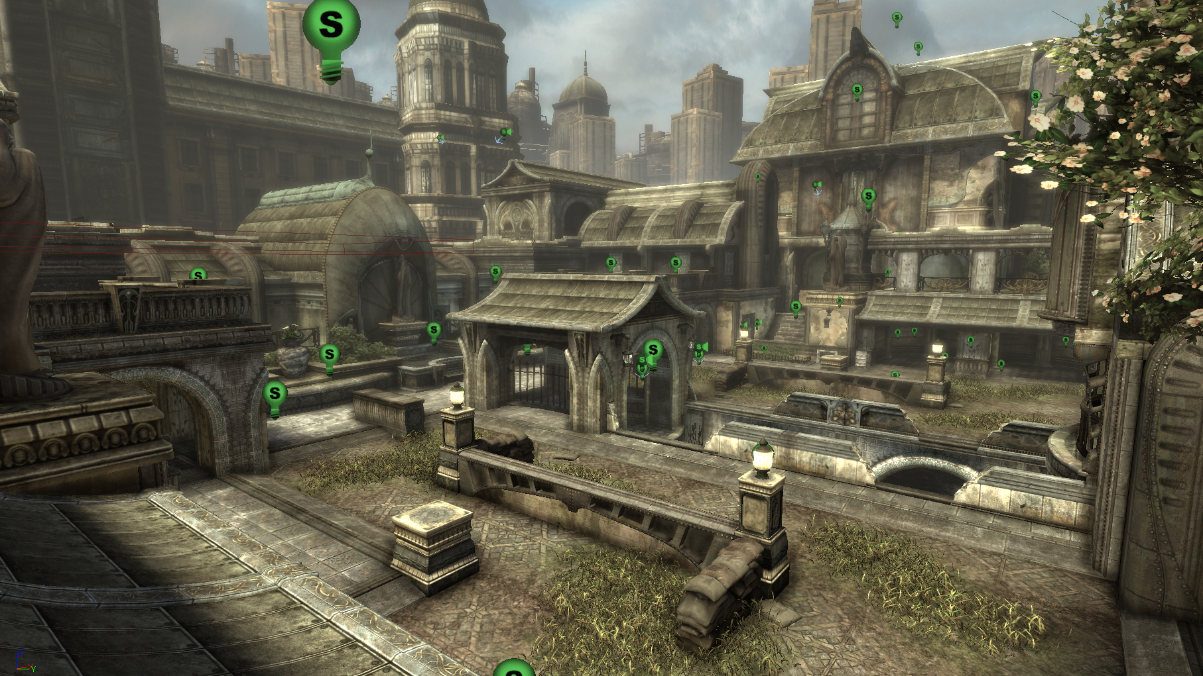
Background
Hundreds of static local light sources in Gears of War 2 levels
Notes:
Gears 2 levels are lit with many static light sources, you can see the light icons in this picture.

Slide 55
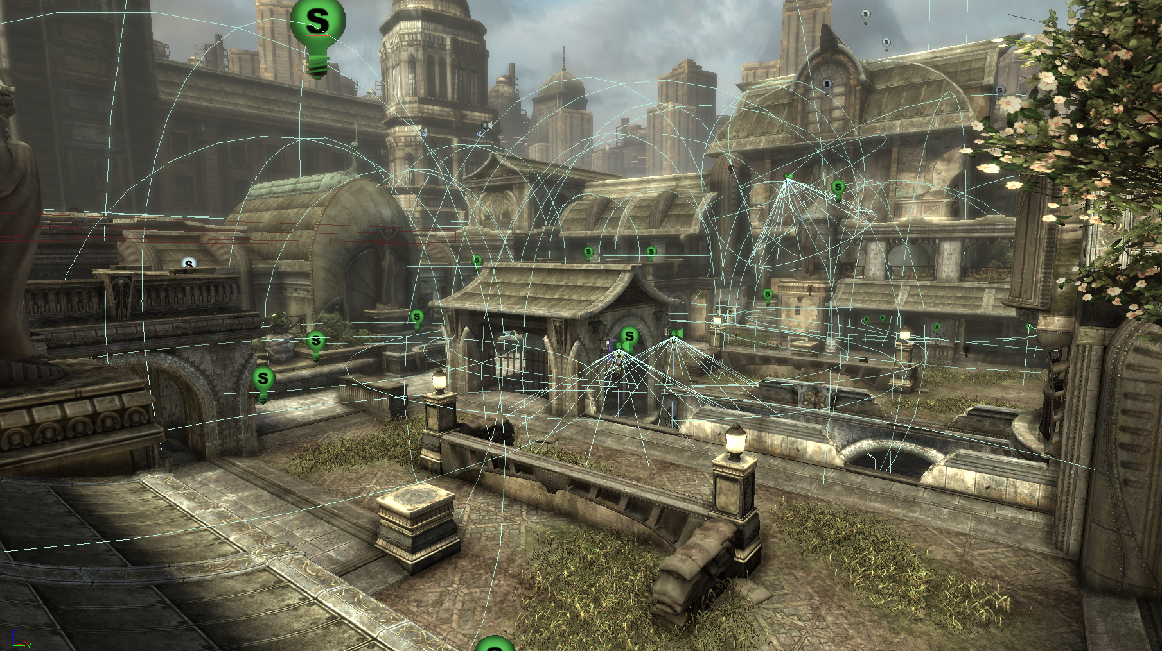
Background
Hundreds of static local light sources in Gears of War 2 levels
Notes:
Here is the same scene with the light influence radii drawn.

Slide 56
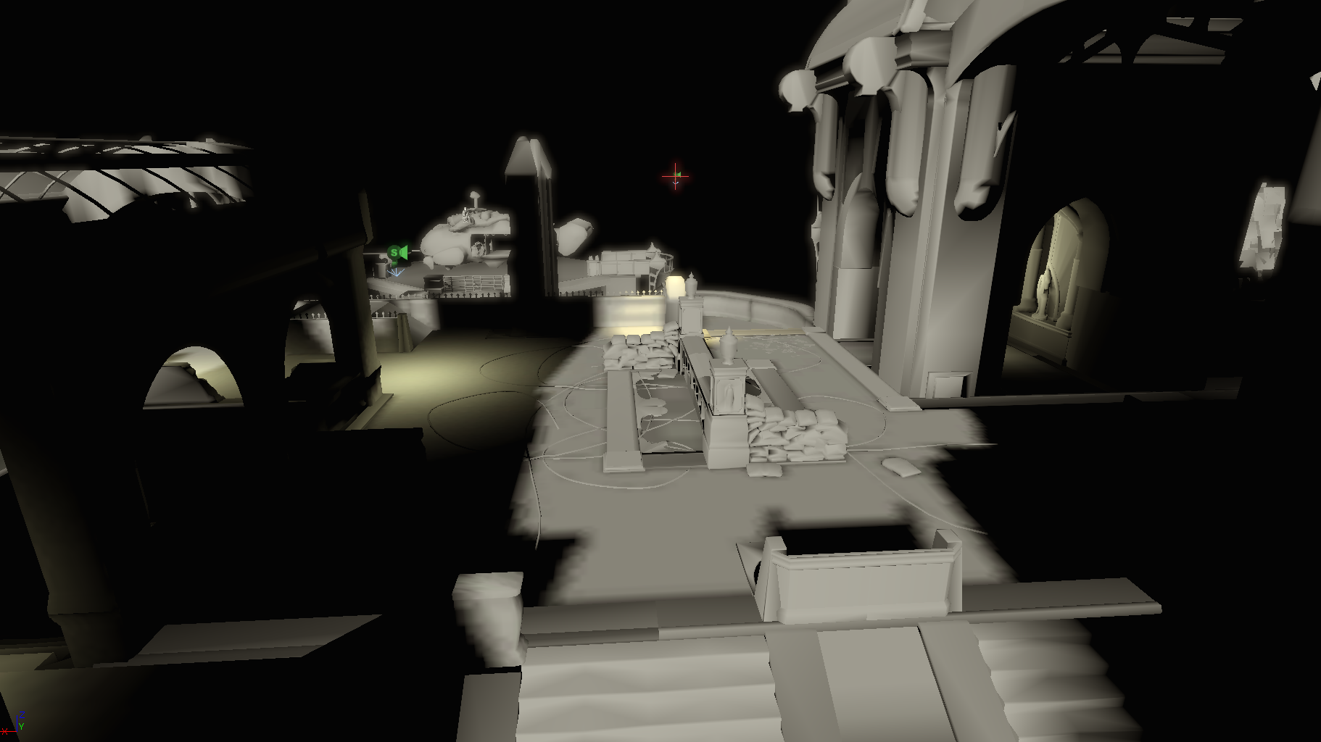
Background
Some of these are dominant light sources
Notes:
Only a handful of these static lights act as dominant light sources and provide the direct lighting part of the rendering equation.

Slide 57
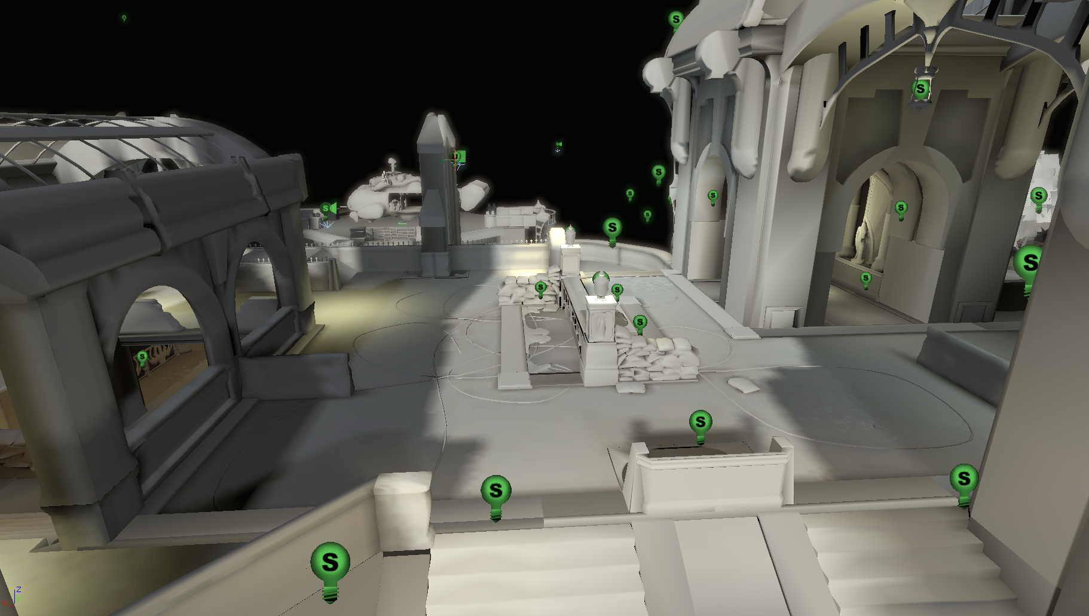
Background
The rest are fill (bounce) lights
Notes:
The rest are fill lights which serve as an approximation to global illumination bounces, and don’t affect level lighting performance since they are built into the light-map.
By default all lights are dominant lights, and artists mark the appropriate ones as fill lights.

Slide 58
Background
Hundreds of static local light sources in Gears of War 2 levels
Too many to light the character dynamically with all of them!
Notes:
Dynamically lighting the character with all of these lights gives the best result, but at a steep and difficult to control performance cost.

Slide 59
Introducing the Light Environment
A Light Environment consists of:
The incident lighting for the object it is responsible for lighting
Update and apply logic
Notes:
We use the term Light Environment to mean a representation of the incident lighting for an object, along with the logic controlling how to update and apply that incident lighting.

Slide 60
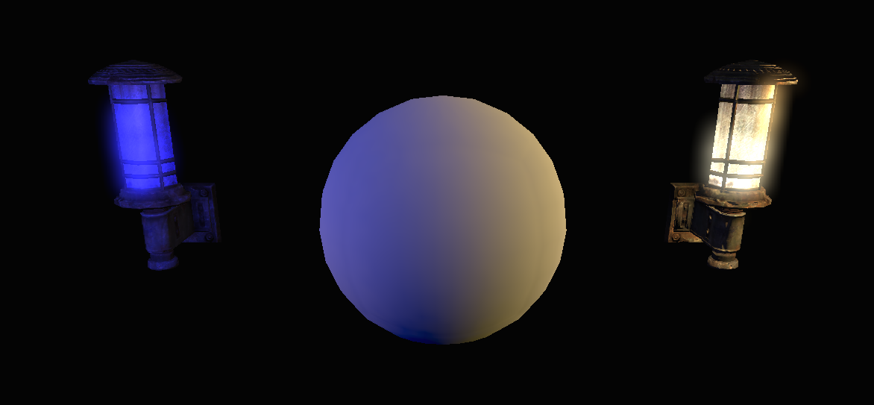
Incident Lighting Representation
Used a Spherical Harmonic basis
9 coefficients
Incident lighting stored in a spherical harmonic basis for two lights
Notes:
A spherical harmonic basis is just an efficient way to represent low frequency incident lighting from all directions for a single point. It serves the same purpose as a cubemap but with a different set of tradeoffs.
We used a 9 coefficient spherical harmonic basis, which gave sufficiently high frequency storage for our needs.

Slide 61
Creating the Light Environment
Dynamically composite relevant lights into the spherical harmonic basis unique for each character
Light visibility determined with ray traces
Separate static and dynamic environments
Notes:
For Gears 2 we composite all the relevant lights into a spherical harmonic basis for each character.
Light visibility is determined with ray traces. To avoid this being a performance bottleneck we separate
the incident lighting into static and dynamic environments.

Slide 62
Creating the Light Environment
Static lights go into the static environment
For the static environment:
Update cost is spread across multiple frames
Update rate is determined by visibility, distance to the viewer, and object importance
Notes:
Lights which do not move or change lighting properties in-game go into the static environment.
For the static environment:
Update cost is spread across multiple frames
Update rate is determined by visibility, distance to the viewer, and user specified object importance

Slide 63
Creating the Light Environment
Every frame
Incident lighting from dynamic lights calculated
Every static update
Final Representation
Incident lighting from static lights calculated
Static environment interpolated
Notes:
The Dynamic environment is updated every frame, and then combined with the interpolated static environment for the final light environment representation.

Slide 64
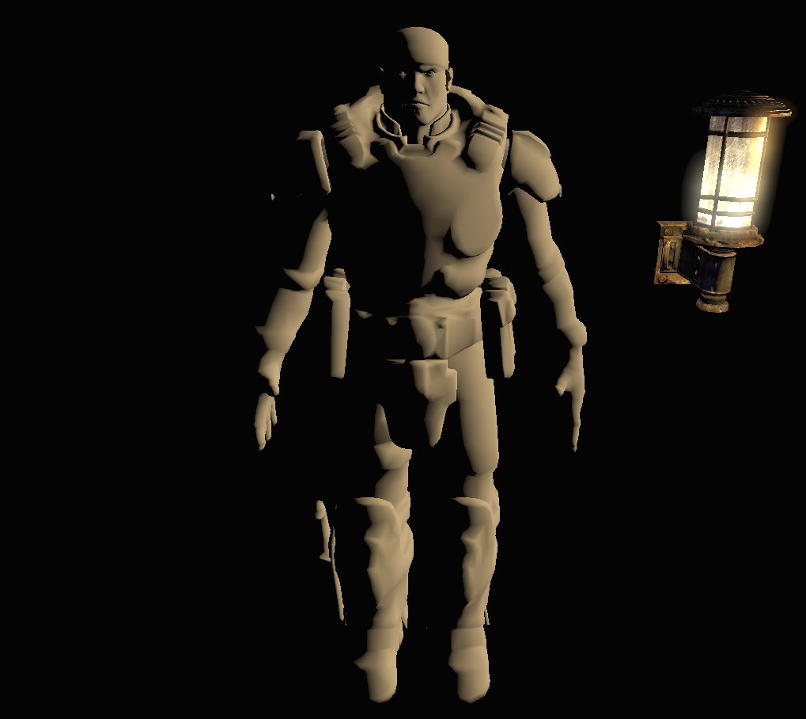
Applying the Light Environment
Directional light for dominant direction
Virtual dominant light
Notes:
Now that we have a representation of the incident lighting on the character, we need to actually apply it to the character.
We extract a virtual directional light from the dominant direction of the spherical harmonic basis and use this on the character to represent direct illumination.

Slide 65
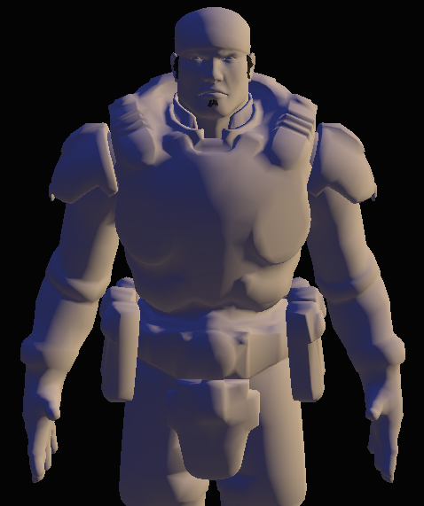
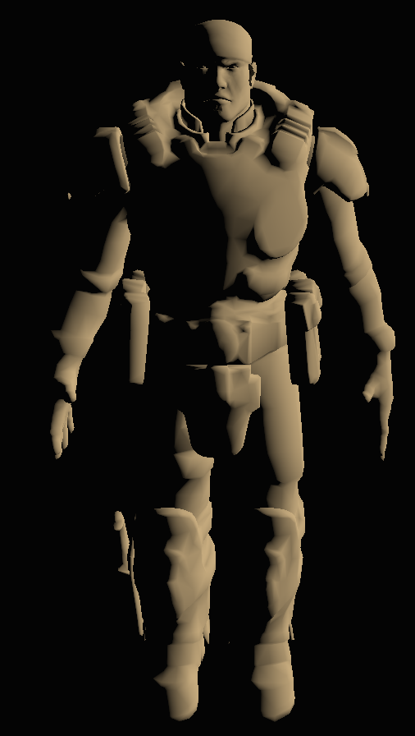
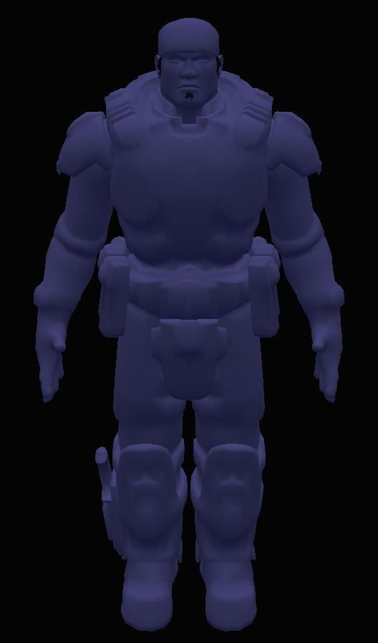
Applying the Light Environment
Dual-Hemisphere light for remaining environment
Medium quality
Direct term
Dual-Hemisphere indirect term
Combined
Notes:
For medium quality lighting we also extract a dual-hemisphere light from what’s left of the light environment. This represents the indirect lighting on the character.
However, the dual-hemisphere light can only represent incident light from above and below so we need a better solution for high quality character lighting.

Slide 66
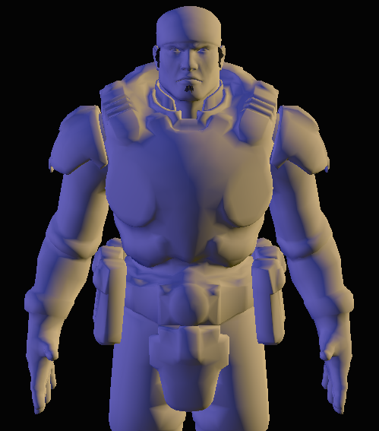
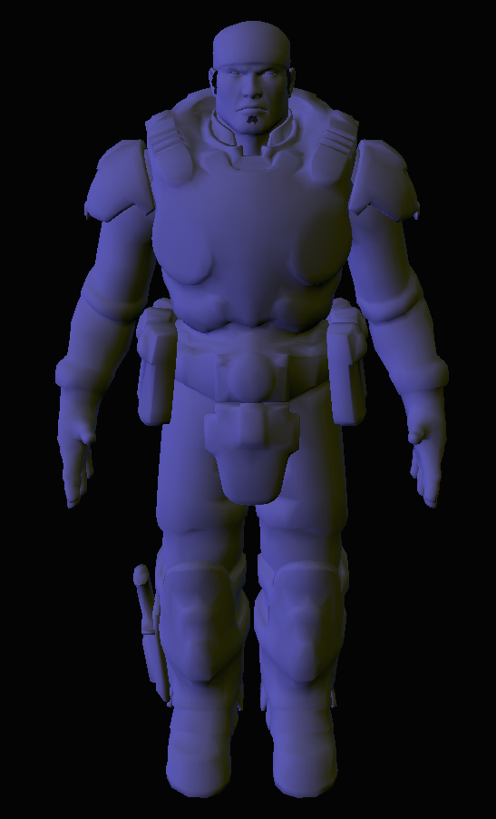
Applying the Light Environment
Directly evaluate remaining SH environment per-pixel
Gives highest quality
Direct term
Spherical Harmonic
Indirect term
Combined
Notes:
We get higher quality by evaluating the remaining spherical harmonic environment per-pixel, which can represent incident lighting from any direction.
This high quality secondary light is used on all characters, and the medium quality version is used on other dynamic objects.

Slide 67
Applying the Light Environment
Fill light
Dominant light
Notes:
Here’s the final result with the actual character material

Slide 68
Applying the Light Environment
Additional dynamic lights can be applied
Useful for quickly changing gameplay lights like muzzle flashes
Artist’s discretion
Notes:
Not all lights affecting the character have to go into the light environment, we can render additional dynamic lights with additive passes. By default all lights are represented by the light environment, but artists can choose which lights are applied with normal dynamic lighting.

Slide 69
Character Shadowing
Shadow direction
Determined by dominant light direction
Fill lights are excluded
Notes:
The shadow direction is determined by the dominant light direction, with fill lights excluded.

Slide 70
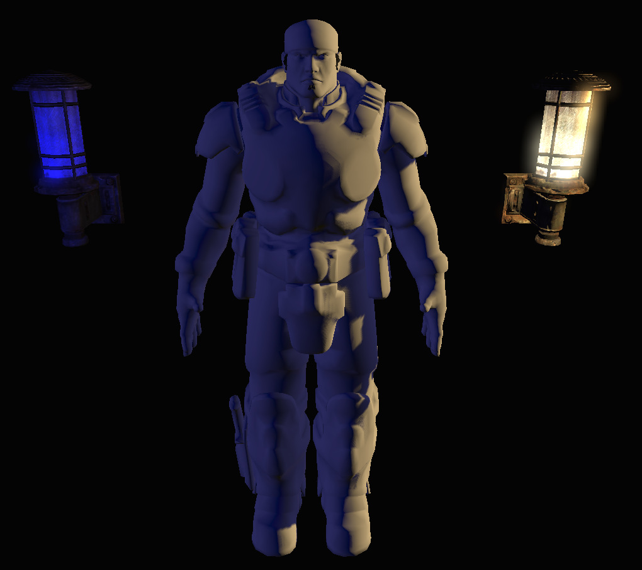
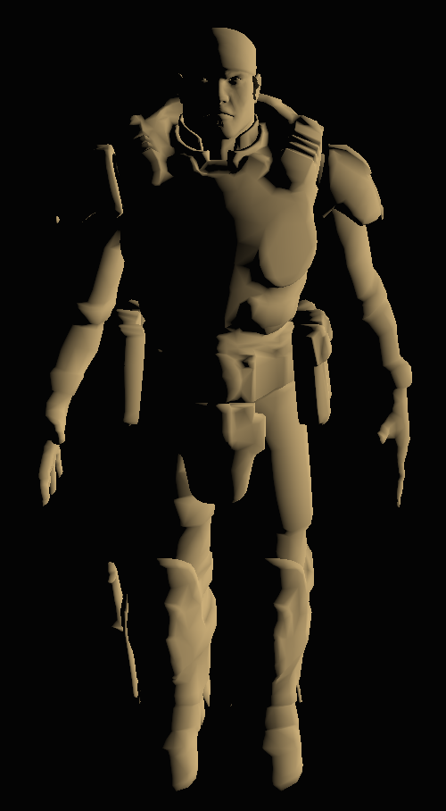
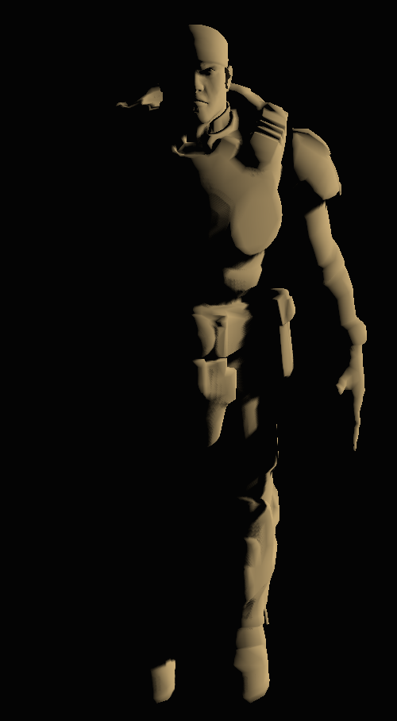
Character Shadowing
Dominant light, shadow,
and unshadowed secondary light
Dominant light
Dominant light and shadow
Notes:
The second light environment light represents indirect lighting on the character, so we want this to not be affected by the direct light shadow. It is applied after the shadows.

Slide 71
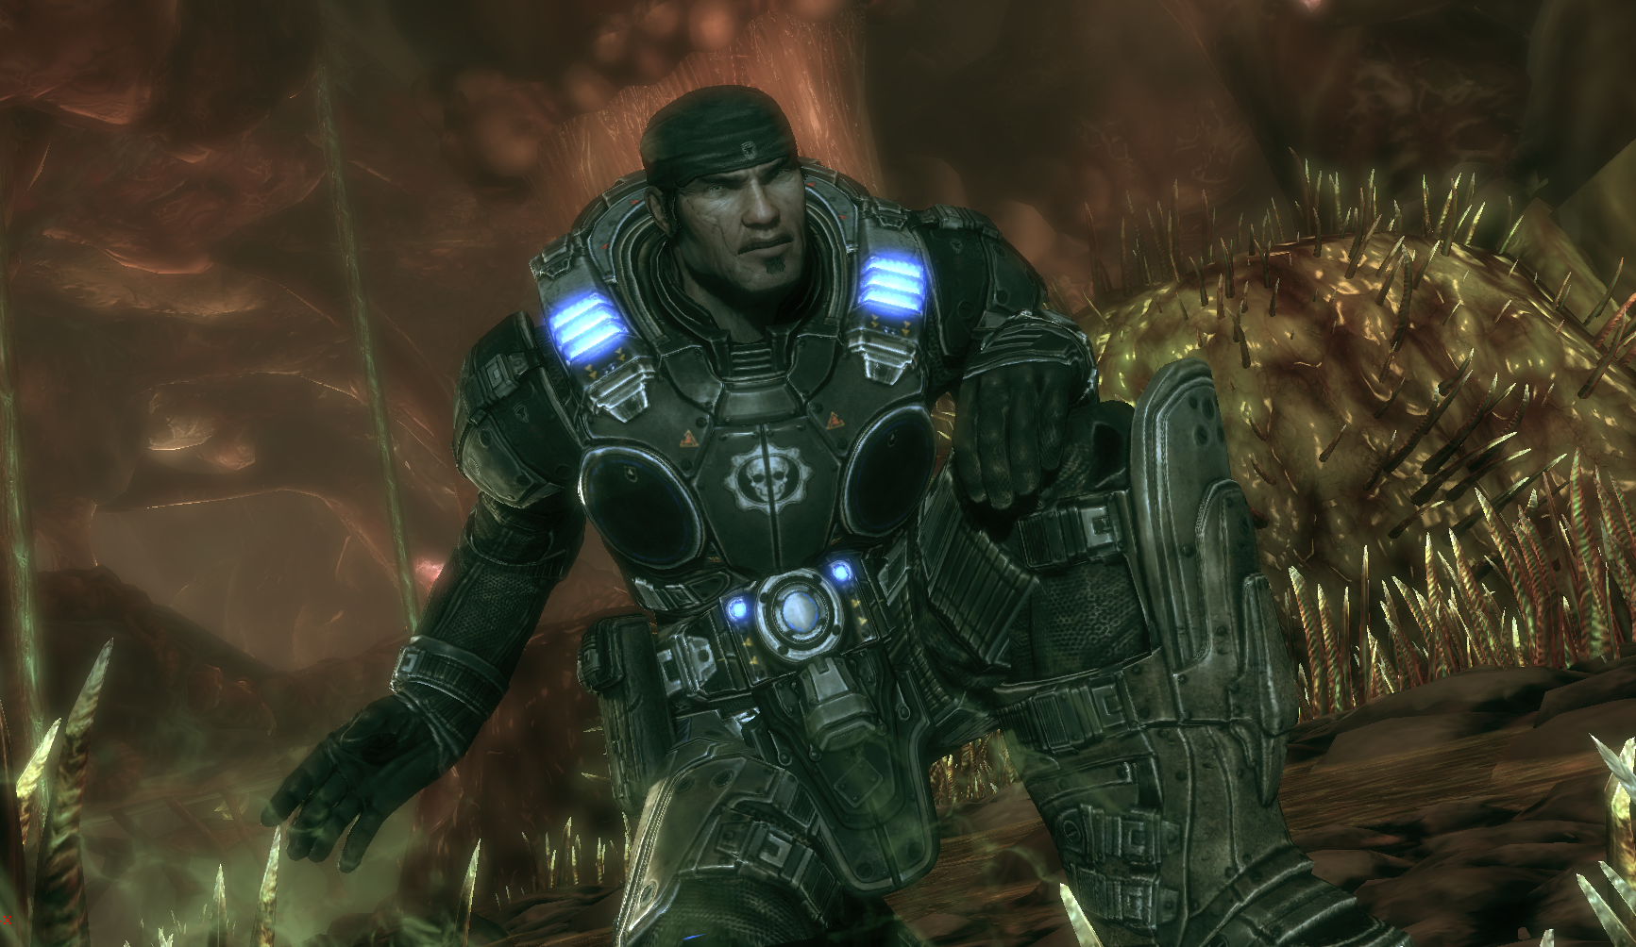
Cinematic Character Lighting
Mix of light environments and multiple shadowed dynamic lights
Whatever looks best for each cinematic
Notes:
For character lighting in cinematics we used a combination of light environments and fully dynamic lighting and shadowing. The parameters of a cinematic are fixed so the performance hazards of using multiple dynamic lights are controllable.

Slide 72
In Conclusion
Combine relevant lights into one efficient representation

Slide 73
Topics Daniel Wright
Gore techniques
Blood techniques
Character lighting
Screen Space Ambient Occlusion optimizations

Slide 74
Topics Daniel Wright
Gore techniques
Blood techniques
Character lighting
Screen Space Ambient Occlusion optimizations
Review
Motivation
Down sampling
Temporal filtering
Computation masking

Slide 75
Screen Space Ambient Occlusion Review
Sample neighbor depths
Compare depth differences
Viewer
Occlusion
Neighbor
Samples
Current Pixel
Notes:
To calculate the occlusion factor in SSAO:
-Sample screen space neighbors
-Compare depth differences between the current pixel and its neighbors
-Use a heuristic based on these depth differences to calculate an occlusion factor

Slide 76
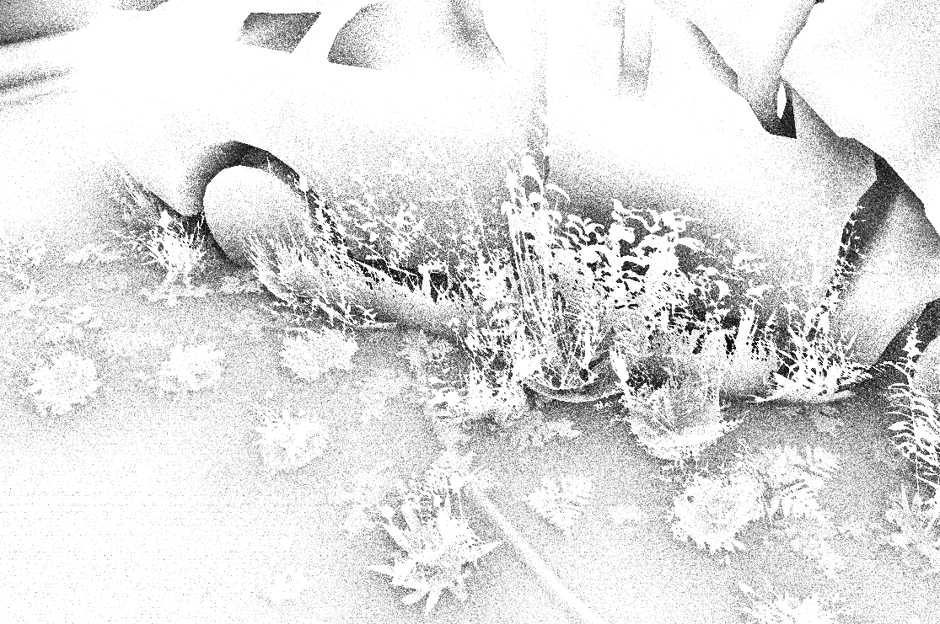
Screen Space Ambient Occlusion Review
Noisy output
Occlusion
Notes:
The output is noisy occlusion to hide view dependence and low sample counts.
We generate cheap noise by reflecting samples across a random normal, which is indexed using each pixel’s screen space position.
As a result, the noise looks much worse when the camera or object is moving.

Slide 77
Screen Space Ambient Occlusion Review
Spatial filter passes
Removes high frequency noise
Edges preserved
Occlusion
Filter
Notes:
To remove the noise we apply a low pass filter.
We have to be careful not to filter too much or distant detail will be lost, or not enough and there will be more flickering.
The filter must preserve edges to avoid occlusion bleeding. This is done by comparing depths of the samples during filtering.

Slide 78
Screen Space Ambient Occlusion Review
PC games have shipped with SSAO as a high end feature
Gears 2 first console game (that we’re aware of)
Many more coming soon!
Lots of available information on making it look good
Only talking about optimizing here
Notes:
PC games have shipped with SSAO as a high end feature, but no console games before GOW2 (that we’re aware of).
This has been implemented in Unreal Engine 3 for a while so you can expect to see it in lots of upcoming licensee games.
There’s a lot of information on how to make SSAO look good, so we’re only talking about optimizing it here, with the target being current generation consoles.
http://developer.amd.com/gpu_assets/S2008-Filion-McNaughton-StarCraftII.pdf

Slide 79
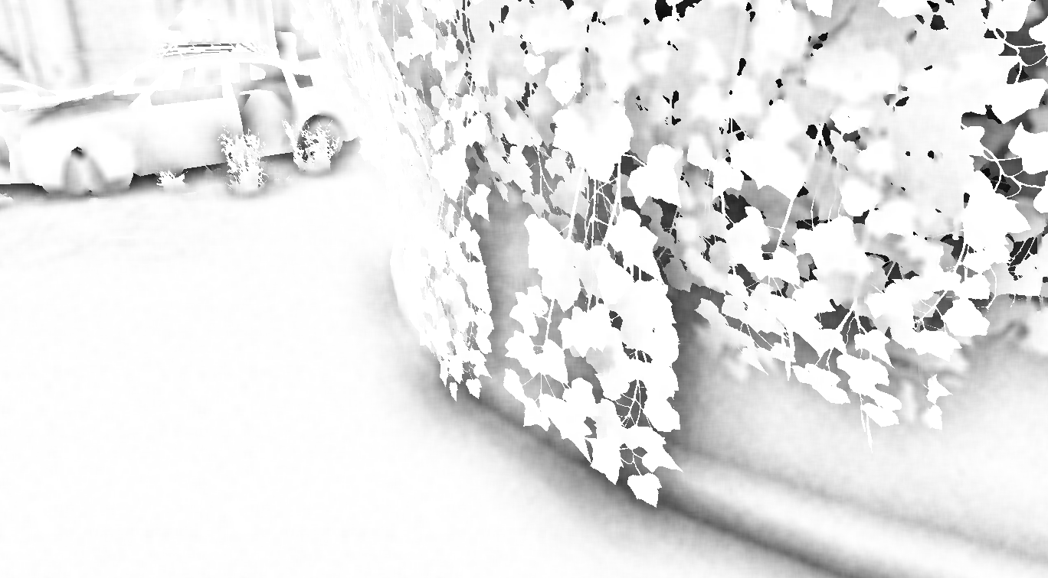
Baseline
720p, 16 occlusion samples, full res, 20 filter samples
Ambient Occlusion only
Notes:
Here’s the configuration that we started out with before optimizations, it consists of:
-a resolution of 720p
-16 neighbor samples in the occlusion pass
-occlusion factor calculated at the same resolution as the scene’s color, so no downsampling
-20 samples to filter the occlusion factor in each direction (x and y)
This configuration is many times too slow to be used in realtime.

Slide 80
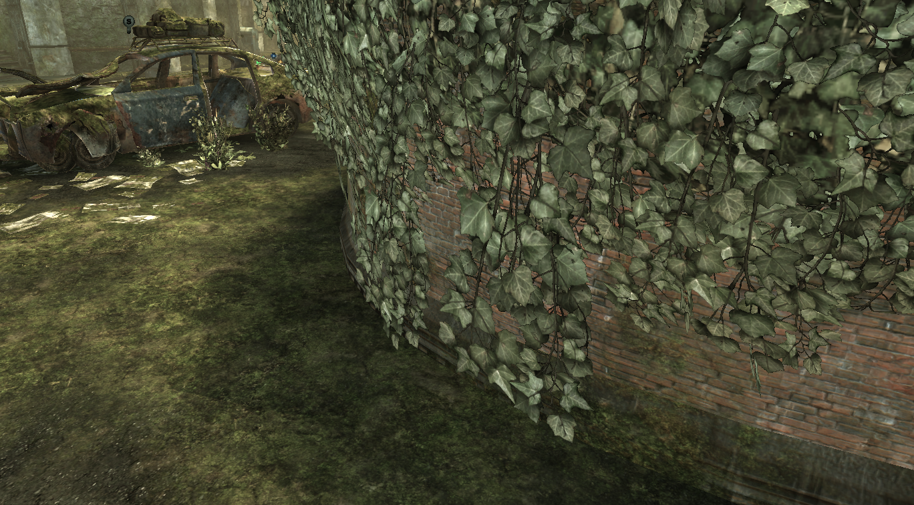
Baseline
720p, 16 occlusion samples, full res, 20 filter samples
Lit
Notes:
Here’s the lit version of that same scene

Slide 81
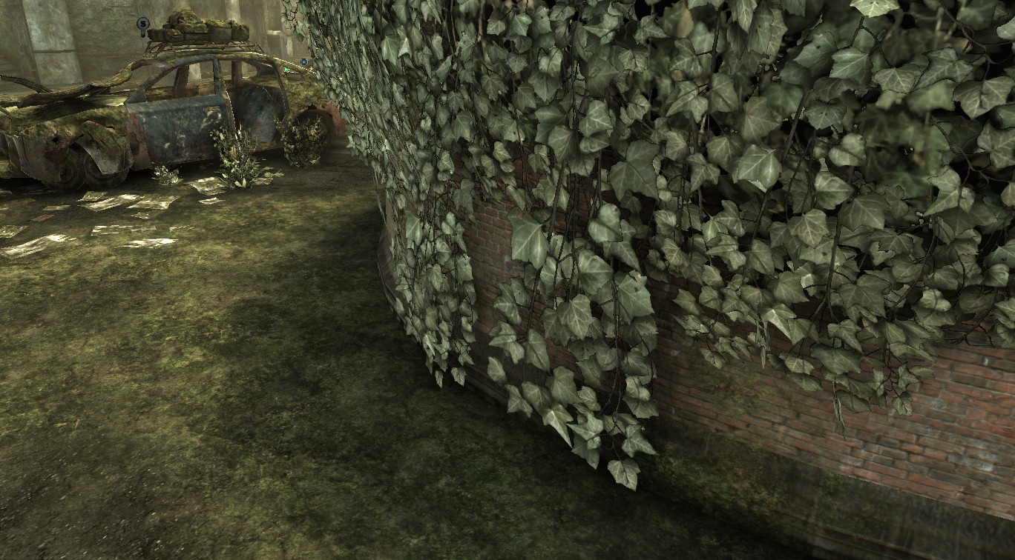
Baseline
720p, 16 occlusion samples, full res, 20 filter samples
Lit and Ambient Occlusion
Notes:
And the viewmode with ambient occlusion applied

Slide 82
Screen Space Ambient Occlusion Optimizations
Motivation
Shortage of GPU resources
Targeting console hardware
Trade off quality for performance
Notes:
We need to AGRESSIVELY optimize the baseline because:
-we are already using most of the GPU’s resources
-our target hardware is current generation consoles, not high-end PC’s
This section is about how we chose to trade off quality for performance

Slide 83
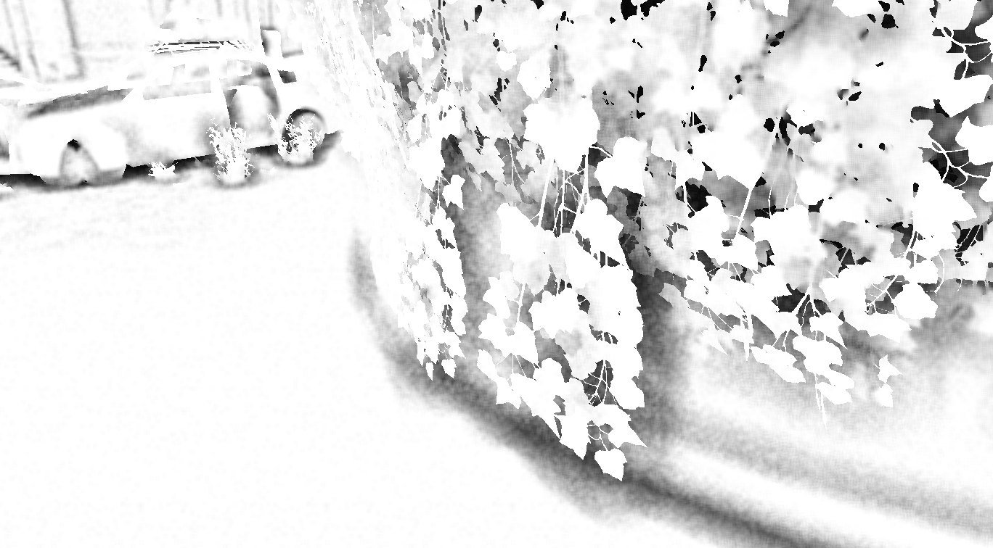
Occlusion Pass
Reduce neighbor samples
Multi-frequency occlusion is lost
8 occlusion samples, 12 filter samples
Notes:
The first thing we tried was lowering the number of neighbor samples from 16 to 8.

Slide 84
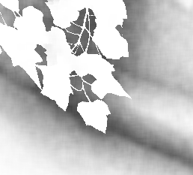
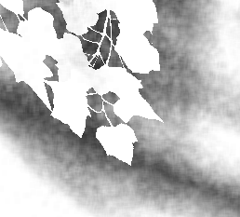
Occlusion Pass
Reduce neighbor samples
Multi-frequency occlusion is lost
16 occlusion samples, 20 filter samples
8 occlusion samples, 12 filter samples
Notes:
Since we are doing less neighbor samples we lose some frequencies of occlusion. This makes the occlusion factor look more like a blob and doesn’t capture detailed geometry as well.
We also lowered the filter samples from 20 to 12 in each dimension, which gives a noisier result, but gave a significant speedup.

Slide 85
Occlusion Pass
Texture cache thrashing
Due to random per-pixel offsets
Clamp offset radius in screen space
Notes:
Since we are using different sample offsets for each pixel to get neighbor depths, a lot of these samples won’t be in the texture cache.
We need to maintain some degree of locality to avoid a performance cliff when none of the samples are in the texture cache, which can make the texture samples up to 10x slower. We clamp the neighbor sample offsets in screen space to avoid this performance hazard.
See the presentation notes for code examples showing how to clamp offsets in screen space.
On the CPU:
// Choose a limit of 70 pixels horizontally
const FLOAT MaxScreenSpaceRadius = 70.0f / AOTargetSizeX;
// Transform screen space radius into a view space horizontal vector.
// Multiplication by view space z is done in the pixel shader.
// ScreenPositionScale.X is the scale from [-1, 1] Normalized device coordinates to screen space
const FLOAT MaxRadiusTransform =
MaxScreenSpaceRadius / (View.ProjectionMatrix.M[0][0] * ScreenPositionScale.X);
On the GPU:
// Clamp the radius in screen space to provide an upper bound on texture cache thrashing
// Radius is a view space distance to be applied to sample positions
Radius = min(MaxRadiusTransform * SceneDepth, Radius);

Slide 86
Down sampling
Downsized render target
AO is mostly low frequency
Down sampled by a factor of two
Notes:
Ambient occlusion is mostly low frequency so an effective way to speed it up is to render the occlusion factor at a smaller resolution than the scene’s color.

Slide 87
Down sampling
Downsized render target
AO is mostly low frequency
Full resolution
Down sampled by a factor of two
Notes:
Once down sampled there are a lot less noisy occlusion values to filter, so more flickering shows through when the camera is moving. Object silhouettes are now more aliased, but the effect is nearly 4 times faster.

Slide 88
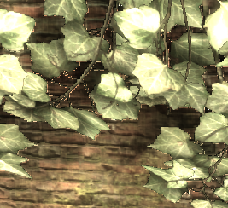
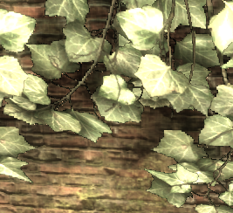
Down sampling
Downsized render target
Use furthest of source depths
Effectively shrinks silhouettes of nearby objects
Using one source depth
Using furthest of source depths
Notes:
Once down sampling, we are only calculating one occlusion factor for multiple scene depths, which results in visible artifacts at silhouettes. Calculating occlusion off of the furthest of the source depths shrinks the silhouette making it much less noticeable.

Slide 89
Down sampling
Downsized render target
Store depth in same render target as occlusion
Occlusion and filtering passes can reuse
Later passes can get occlusion and depth with one texture lookup
Using RG16F
Ended up using a down sample factor of two
Reduces Xbox 360 resolve cost by a factor of four
Down sample
Occlusion
Filter
Notes:
It makes sense to down sample depth before calculating occlusion, so we only have to do it once.
By storing down sampled depth in the same render target as the occlusion factor we can halve the number of texture lookups required in the filtering passes.
Downsampling also reduces resolve cost on the Xbox 360 which can be significant since we are doing many passes to process the occlusion.

Slide 90
Results
Notes:
At this point we have a fairly fast ambient occlusion effect but unacceptable noise when either the camera or an object moves.

Slide 91
Temporal Filter
Motivation
Large spatial filters needed to hide low occlusion samples
Detail is lost with large filters
Lots of variance between frames
Notes:
We have to use a large spatial filter kernel to decrease the noise to an acceptable level, but occlusion detail is lost with large filters.
There’s a lot of variance between frames so what we really want is to be able to filter this frame’s occlusion result with the previous frame’s results.

Slide 92
Temporal Filter
Filter the occlusion factor over time
Reverse Reprojection Caching
Use as a filter instead of an optimization
Down sample
Occlusion
Filter
Temporal Filter
Notes:
A technique called Reverse Reprojection Caching lets us do just that. Reprojection Caching is usually used as an optimization, but we can use it as a filter too. It operates at the end of the ambient occlusion processing chain.
http://ati.amd.com/developer/gdc/2007/Nehab-Accelerating_Real-Time_Shading_with_Reverse_Reprojection_Caching(GH07).pdf

Slide 93
Temporal Filter
Reverse Reprojection Caching
If last frame’s value is invalid, throw it away
Lookup this frame and last frame’s occlusion values
Update the history with new occlusion
Otherwise
New = lerp(Current, Old, Rate)
Notes:
Here’s a summary of how Reprojection Caching works:
When rendering the scene, calculate both this frame and last frame's positions and pass them to each pixel.
For each pixel, look up the cached occlusion value from last frame and the depth that it was cached at.

Slide 94
Temporal Filter
Reverse Reprojection Caching
If last frame’s value is invalid, throw it away
Lookup this frame and last frame’s occlusion values
Update the history with new occlusion
Otherwise
New = lerp(Current, Old, Rate)
Notes:
If the pixel was off the screen or occluded last frame, throw last frame's occlusion away.
-We can detect if it was off screen by checking that last frame’s projected position is inside the screen
-We can detect if it was occluded by comparing the depth the current pixel was at last frame with the actual depth that the occlusion value was cached at.

Slide 95
Temporal Filter
Reverse Reprojection Caching
If last frame’s value is invalid, throw it away
Lookup this frame and last frame’s occlusion values
Update the history with new occlusion
Otherwise
New = lerp(Current, Old, Rate)
Notes:
Otherwise the pixel was on screen and unoccluded last frame, so filter the current occlusion value with it.

Slide 96
Temporal Filter
Reverse Reprojection Caching
If last frame’s value is invalid, throw it away
Lookup this frame and last frame’s occlusion values
Update the history with new occlusion
Otherwise
New = lerp(Current, Old, Rate)
Notes:
Finally, update the cache with this frame’s occlusion and depth. This is the temporal filter.

Slide 97
Temporal Filter
Dynamic objects
Source Position
Last Frame
This Frame
Animation
Animation
World space position
World space position
Screen space position
Screen space position
Notes:
Reprojection caching requires this frame AND last frame’s screen space position for each pixel.
For Dynamic objects, we have to transform each vertex twice using this frame and last frame’s animation and view transforms.

Slide 98
Temporal Filter
Static objects
Source Position
Animation
World space position
Last Frame
This Frame
Screen space position
Screen space position
Notes:
But for static objects, we can calculate last frame’s screen space position using this frame’s world position, since only the view and projection transforms have changed. This means we can update the history for all static pixels with just a full screen quad and no extra object rendering. This is a crucial observation because otherwise we would have to do another pass over the whole scene to do Reprojection Caching which would not be acceptable performance-wise.

Slide 99
Temporal Filter
Update history of all pixels as if they were static
Overwrite with correct value for dynamic objects
Depth testing
Down sample
Occlusion
Filter
Temporal Filter Static
Temporal Filter Dynamic
Notes:
We can update the history of all pixels as if they were static, and then overwrite with the correct value for pixels belonging to moving objects. The static update is very quick so there’s not much wasted time if the pixel did belong to a moving object. When updating the history of dynamic objects, we need to do depth testing. Because we are still operating at a different resolution than the scene’s depth buffer, we need to either manually depth test or construct a down sampled depth buffer. We use the down sampled depth buffer because it provides a much faster depth test and supports stencil operations.

Slide 100
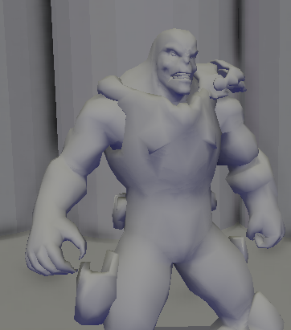
Temporal Filter
Newly Unoccluded pixels
New Pixels
Halo regions
Character movement
direction
Notes:
Newly unoccluded pixels pose a problem for SSAO because they lie in ‘halo’ regions. Halo regions are areas where a foreground occluder has blocked out some of the background depths so we cannot calculate an accurate occlusion value, due to operating in screen space. If we throw away the history value because a pixel was occluded last frame, there will be a visible trail behind foreground objects as the pixels they reveal are updated with a halo occlusion value. Instead we choose to keep the history value, which results in a less noticeable artifact.

Slide 101
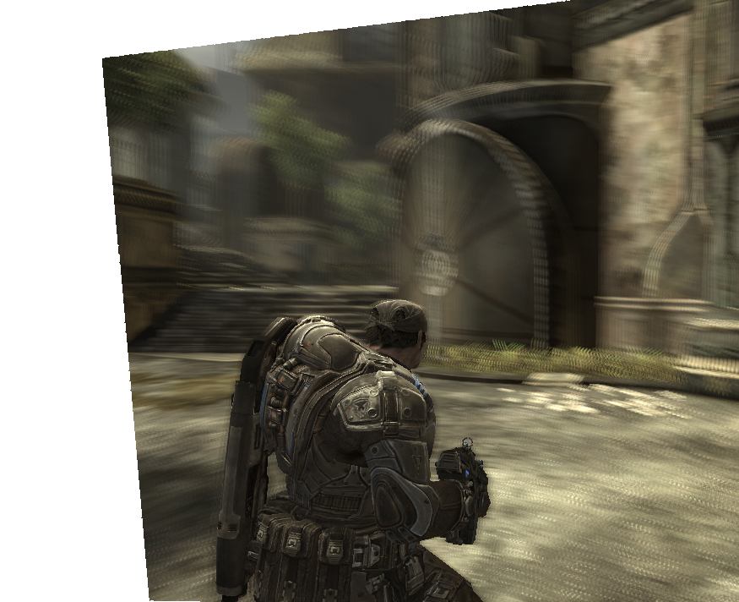
Temporal Filter
Additional convergence control
New pixels from camera rotation for one frame
Accelerating Convergence over multiple frames
Pixels with an existing history
Constant Convergence Rate
Notes:
So far occlusion results will converge at the same rate all over the screen. This means that fast camera panning will reveal new pixels at the edge of the screen which haven’t converged yet. We can improve on this by storing a running convergence weight along with the occlusion factor in the history buffer. At every update we increase the running convergence, and new pixels at the edge of the screen have their running weight reset. The result is that new pixels converge much faster, making the artifacts less noticeable.

Slide 102
Without Temporal Filter
Notes:
Here’s the ambient occlusion without the temporal filter again

Slide 103
With Temporal Filter
Notes:
And here’s the effect of the temporal filter in action.

Slide 104
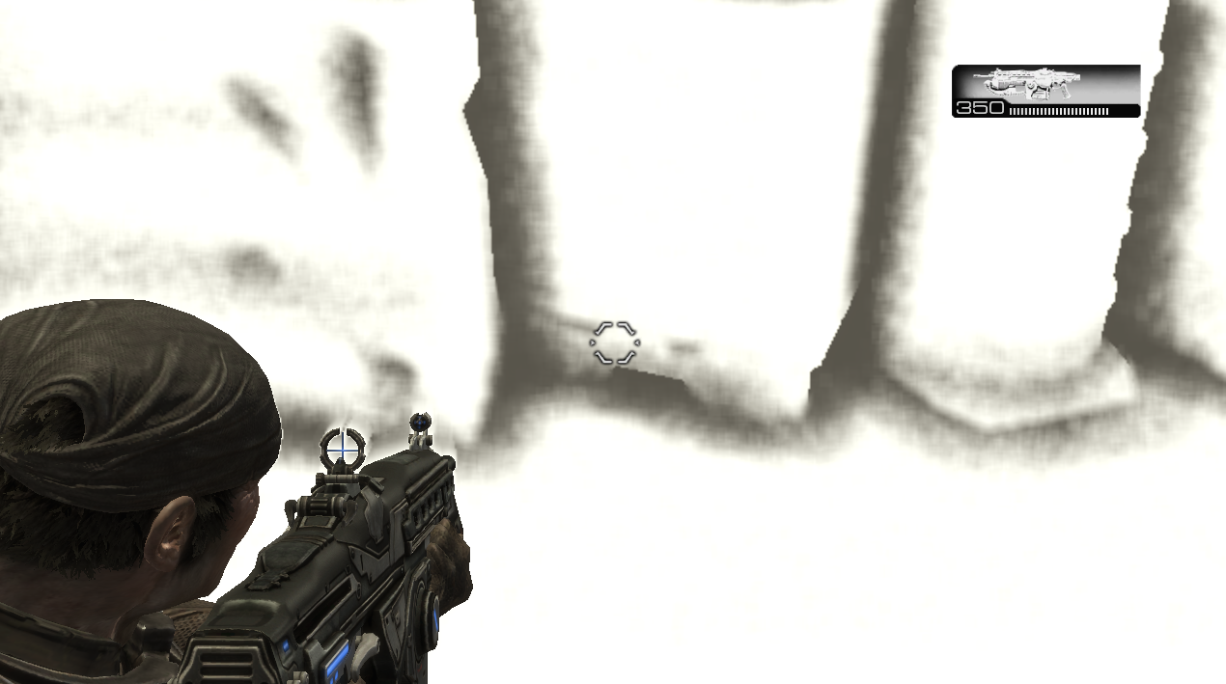
Temporal Filter
Doesn’t help with static camera/objects
Notes:
Because the noise is based off of screen space position, the temporal filtering only has an impact when either the camera or object is moving. We can add random jitter each frame to get around this, but it tends to make the occlusion flow in an undesirable way. In general it is more difficult to notice the noise when nothing is moving anyway.

Slide 105
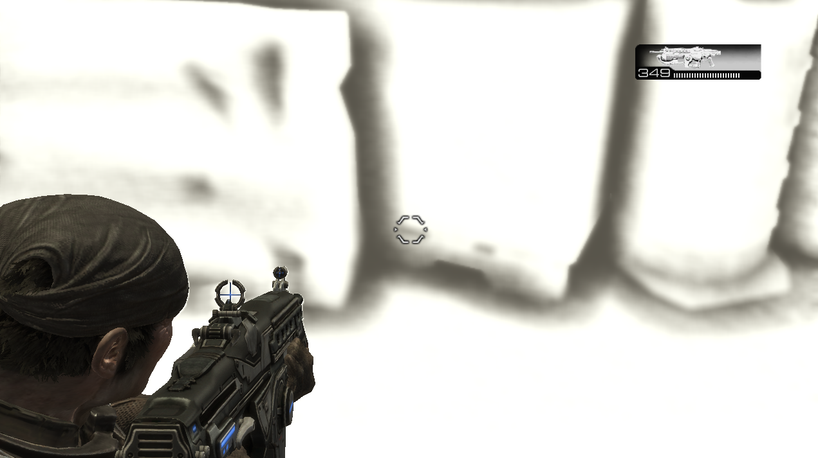
Temporal Filter
Almost all flickering gone with moving camera
Can get away with less occlusion samples, less filter samples
Camera moving
Notes:
Now that we are filtering between frames we can use lowered occlusion and filter samples without as many artifacts.

Slide 106
Temporal Filter Gotchas
Accurate last frame position
Bilinear filtering
Double buffer
World space precision
Notes:
There are a few things to watch out for when implementing Reprojection Caching, the first is to make sure your last frame’s position is exact. This means taking into account half pixel offsets for D3D and not reusing per-pixel velocity from motion blur if that has been tweaked for a certain look. Any discrepancy and you will get strangely flowing occlusion factors.
Last frame’s cached occlusion won’t map exactly to this frame, so resampling is needed. The history buffer must support linear filtering, which works fine for resampling occlusion values.
It is necessary to double buffer the history since the update reads from outside the current pixel.
When updating the history for static pixels, be careful to not actually transform positions through world space but instead transform them through world space centered around the camera’s position. This will avoid floating point error from distorting the history lookup.

Slide 107
Temporal Filter Limitations
Skeletal meshes
Not detecting cache misses for every sample
Streaks where moving objects meet
Notes:
We don’t calculate an accurate last frame’s position for skeletal meshes due to bone limits so we can’t apply the temporal filter to these pixels.
We are also not detecting cache misses for every neighbor sample, just for the pixel being shaded. This tends to cause streaking where moving objects meet and as a workaround we have a per-object flag to disable occlusion.

Slide 108
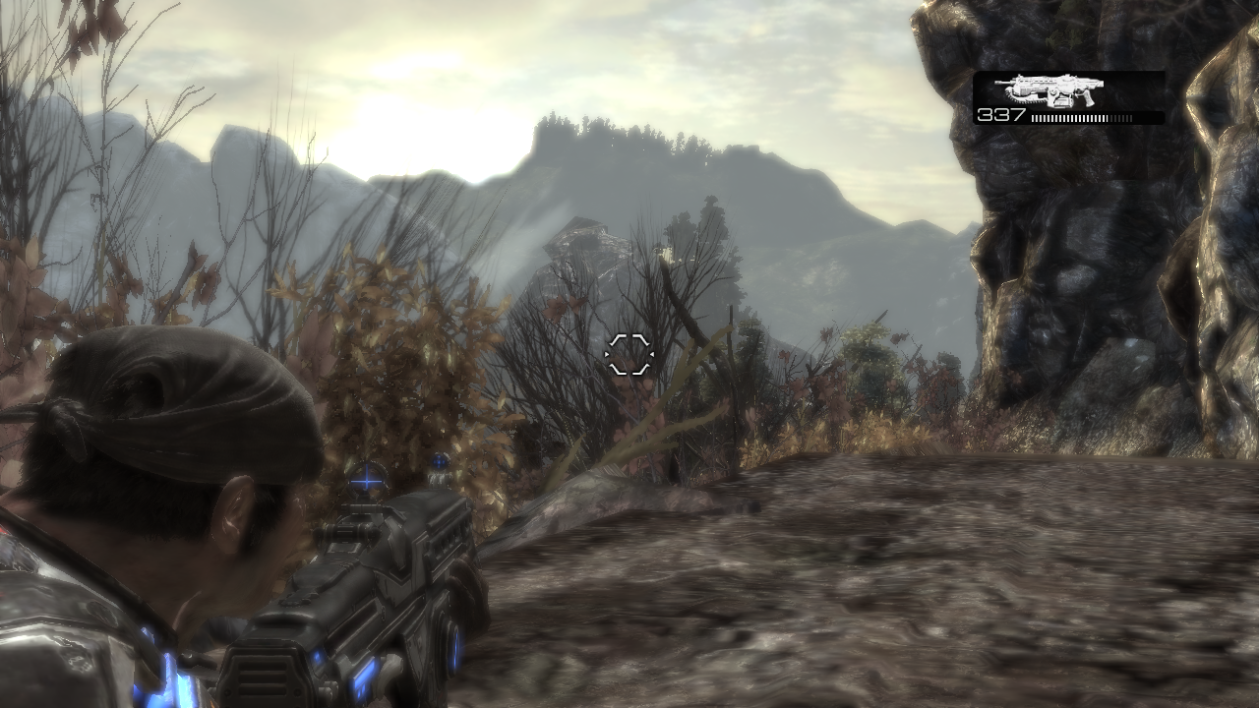
Computation Masking
Pixels with minimal occlusion
Notes:
There are several cases with minimal visible occlusion which we can take advantage of.

Slide 109
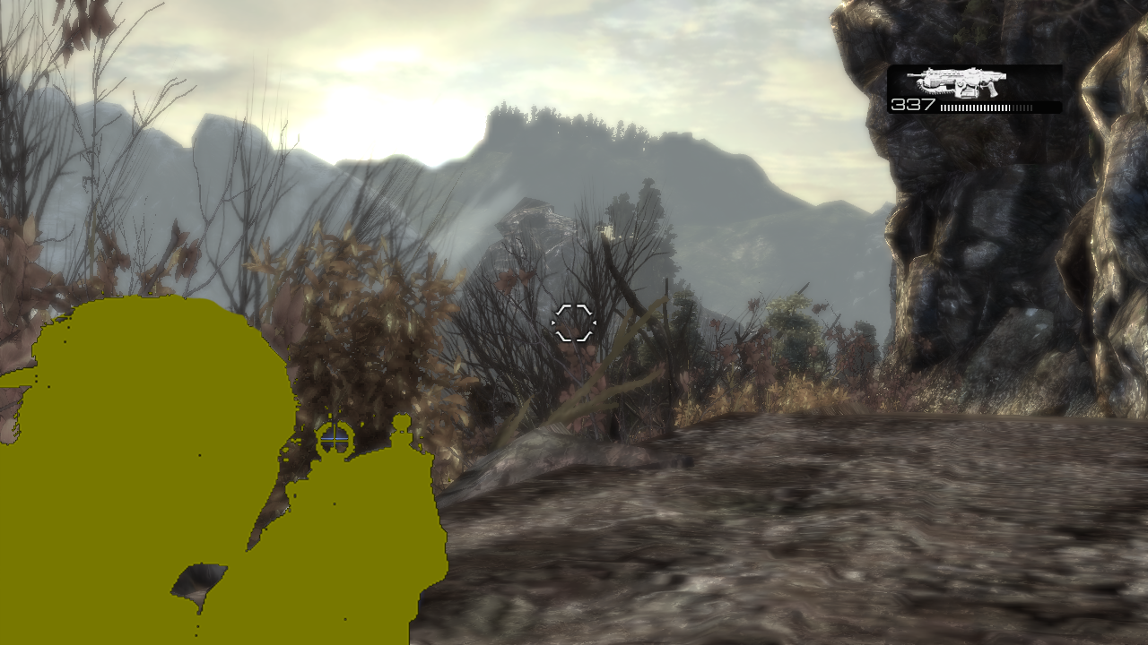
Computation Masking
First person weapon
Notes:
The first case is the first person weapon, and objects marked to not cause occlusion.

Slide 110
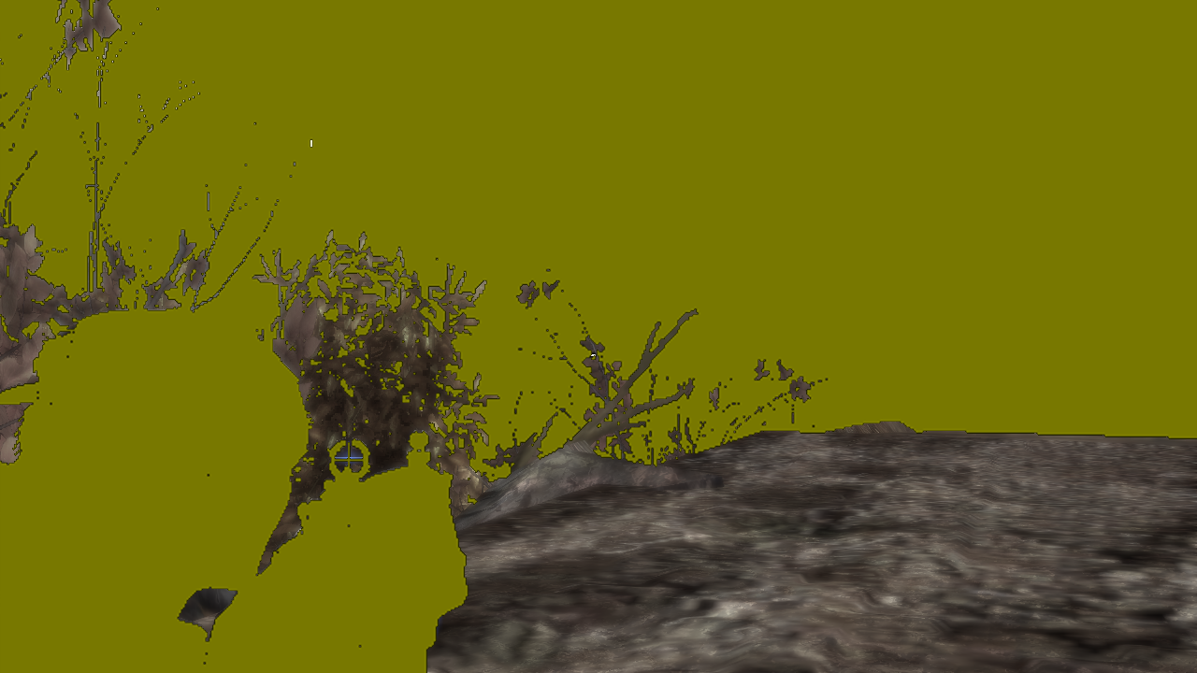
Computation Masking
Distant pixels
Notes:
Distant pixels also do not cause noticable occlusion.

Slide 111
Computation Masking
Cull these pixels with Hi-Stencil
Requires use of down sampled depth/stencil buffer
Special fast case for distance
Computation mask
Notes:
We setup a Hi-Stencil mask to cull pixels in the occlusion, filter and history update passes based on these criteria. Setting up the distant pixel stencil mask is particularly efficient since we can place a quad at the cutoff distance and just setup the stencil mask for pixels which pass the depth test.

Slide 112
In Conclusion
Use Reverse Reprojection Caching as a temporal filter
Use Computation Masking to avoid doing work where it won’t be noticed

Slide 113
Questions?
niklas.smedberg@epicgames.com
daniel.wright@epicgames.com

